Slide 1
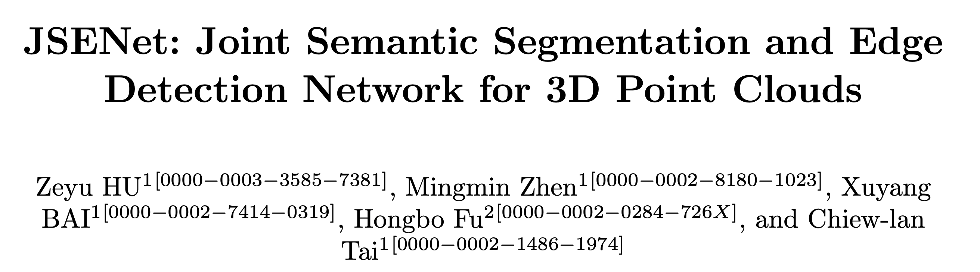
Xing Li
2020/11/21

Slide 2
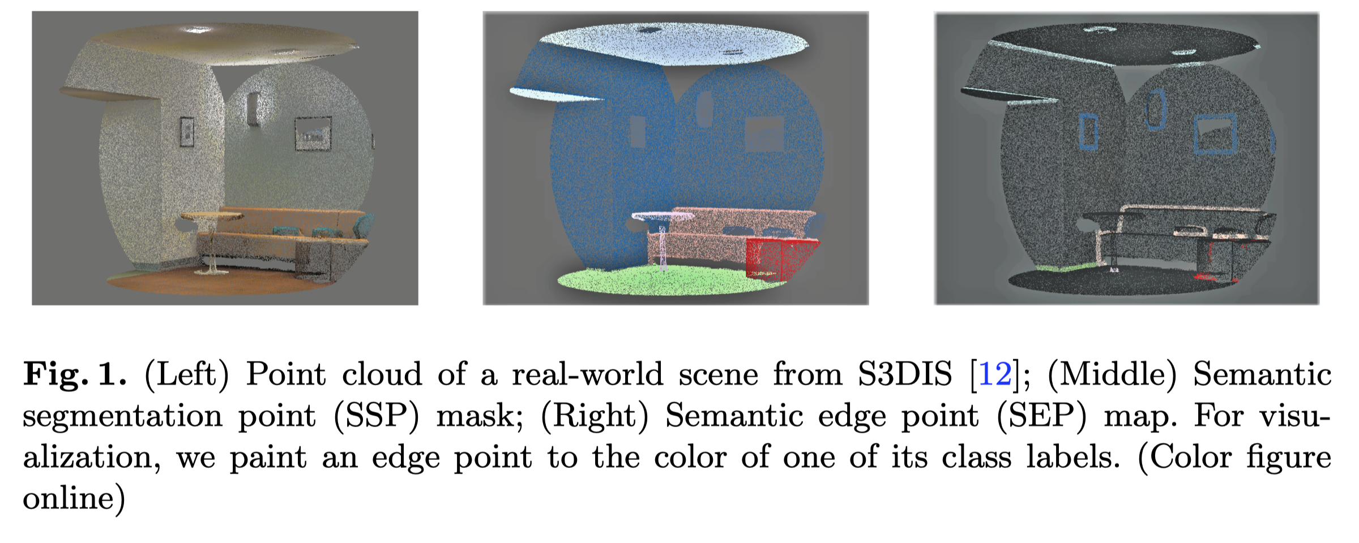
Motivation
sharpen the boundaries of the predicted SS results
suppress network activations on the non-semantic edges

Slide 3
Contribution
introduce the task of SED into the 3D ﬁeld and design an FCN-based architecture with enhanced feature extraction and hierarchical supervision to generate precise semantic edges
propose a novel framework for joint learning of SS and SED, named JSENet, with an eﬀective lightweight joint reﬁnement module that brings improvements by explicitly exploiting the duality between the two tasks
propose a dual semantic edge loss, which encourages the network to produce SS results with ﬁner boundaries

Slide 4
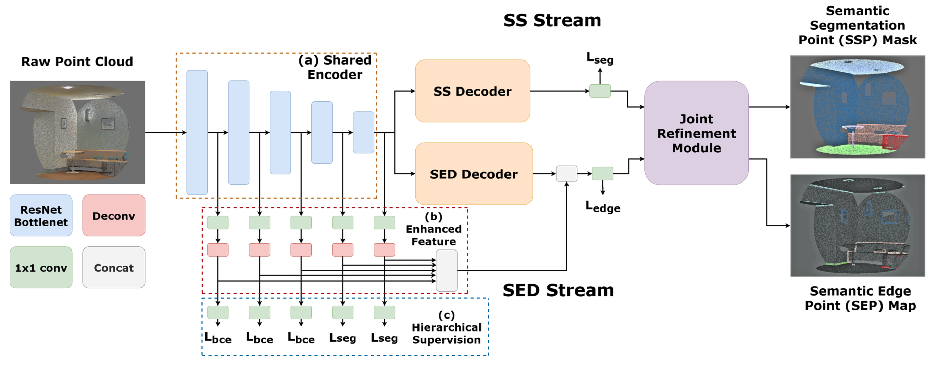
Pipeline

Slide 5
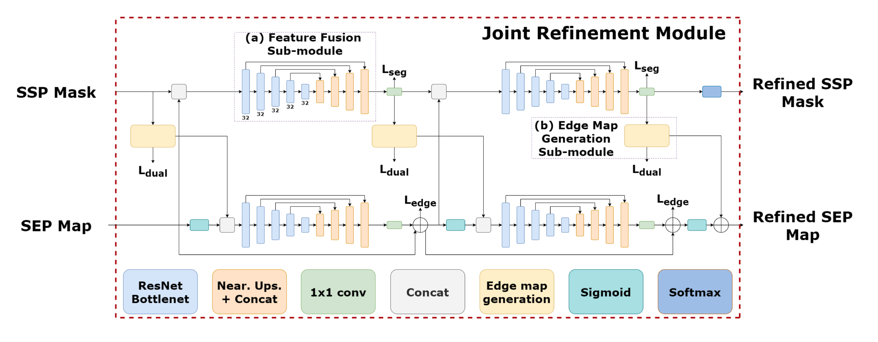
joint reﬁnement module

Slide 6
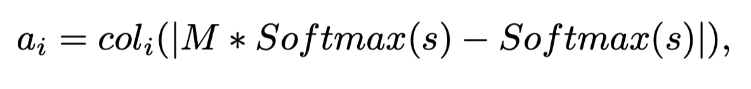
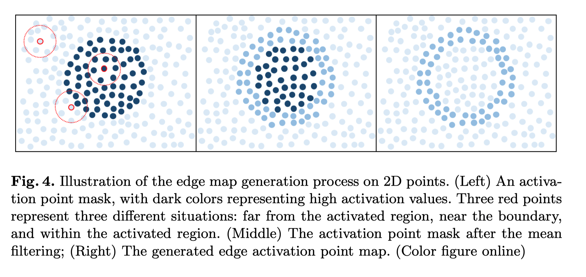
Edge Map Generation Sub-Module

Slide 7
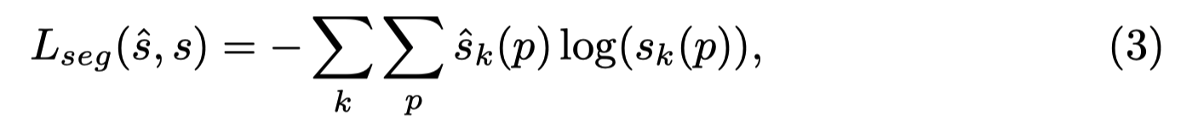
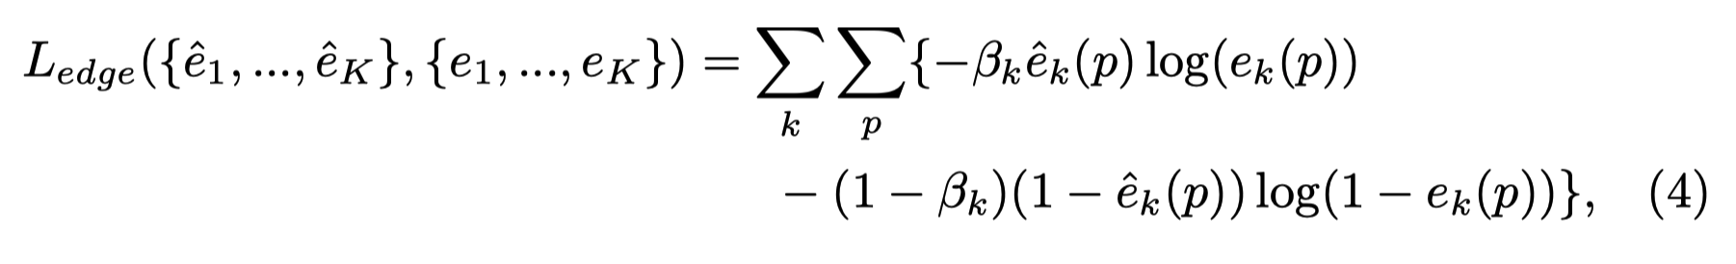
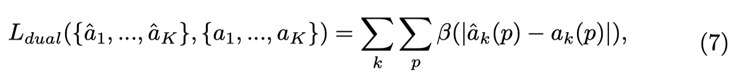
Joint Multi-task Learning

Slide 8
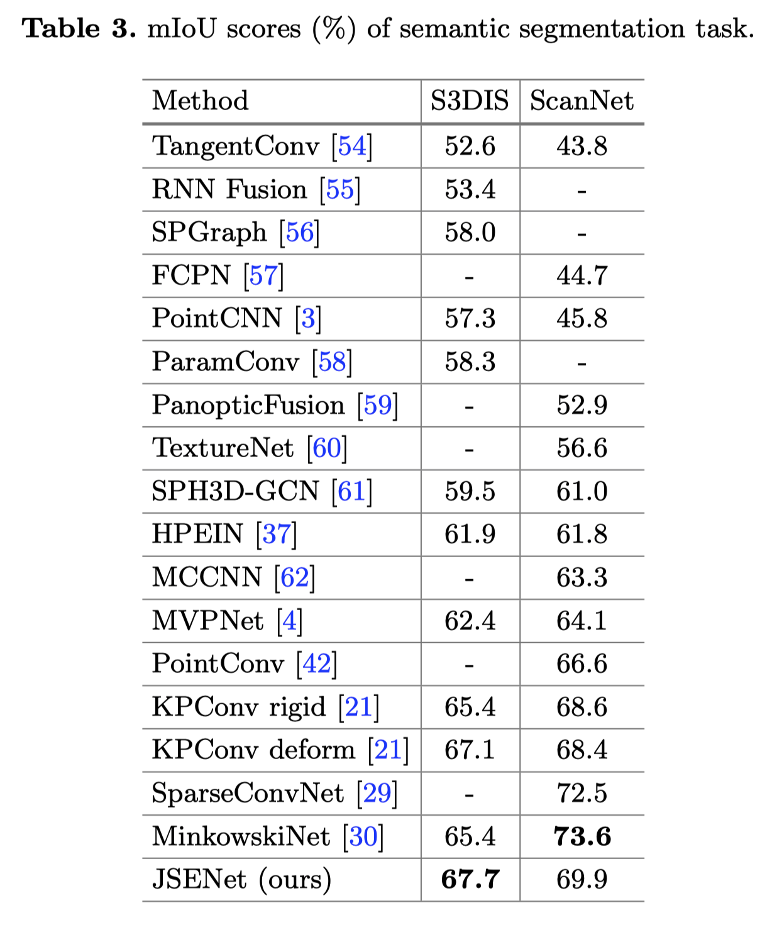
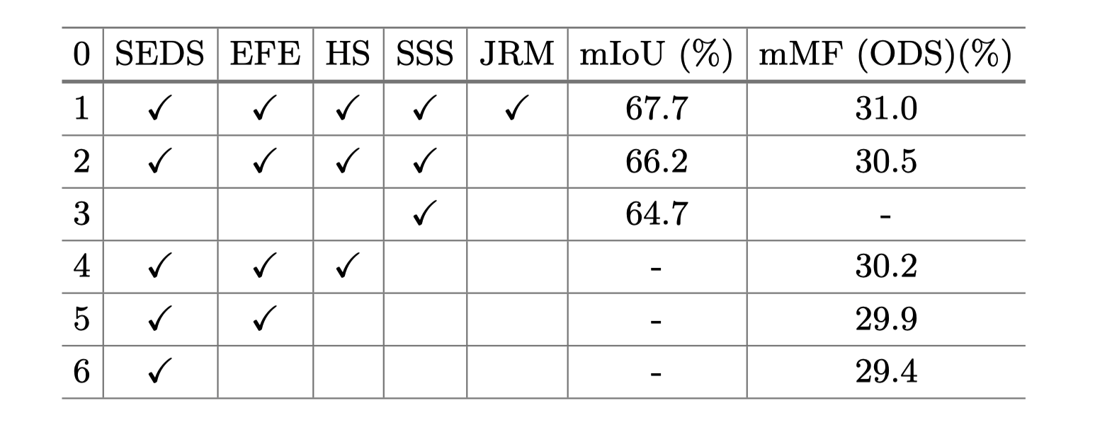
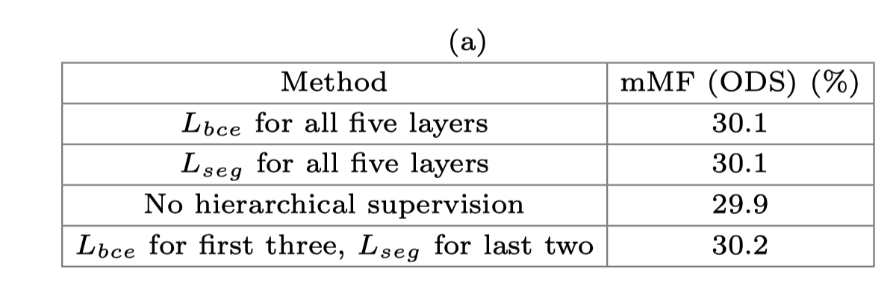
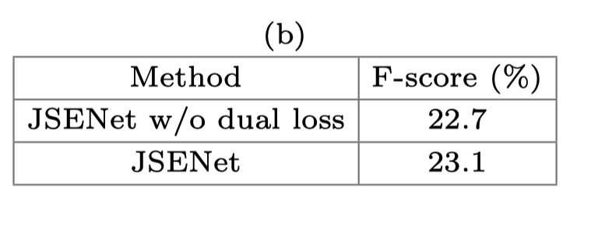
Experiments

Slide 9
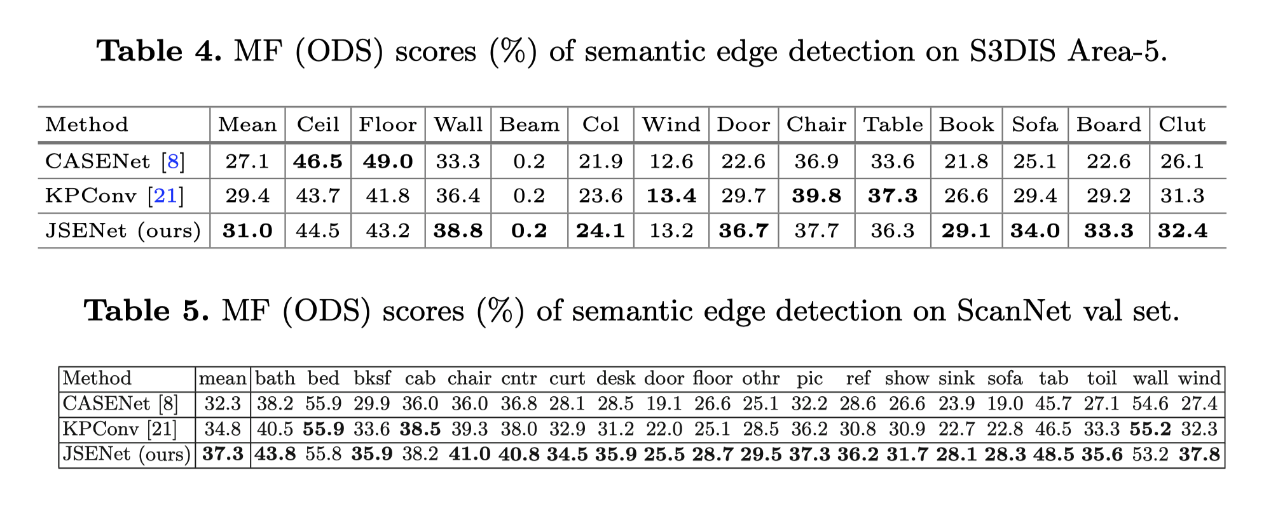
Experiments

Slide 10
Thank You!

